Slide 1
FOREST COVER TYPE
MACHINE LEARNING PROJECT
SUBMITTED BY:
→VAIBHAV TAYAL

Slide 2
OBJECTIVE
To predict type of forest cover using different machine learning models

Slide 3
DESCRIPTION
In The given task predict the forest cover type (the predominant kind of tree cover) from strictly cartographic variables (as opposed to remotely sensed data).
The actual forest cover type for a given 30 x 30 meter cell was determined from US Forest Service (USFS) Region 2 Resource Information System data. Independent variables were then derived from data obtained from the US Geological Survey and USFS.
The data is in raw form (not scaled) and contains binary columns of data for qualitative independent variables such as wilderness areas and soil type.
This study area includes four wilderness areas located in the Roosevelt National Forest of northern
Colorado.
These areas represent forests with minimal human-caused disturbances, so that existing forest cover types are more a result of ecological processes rather than forest management

Slide 4
The study area includes four wilderness areas located in the Roosevelt National Forest of northern Colorado.
Each observation is a 30m x 30m patch. You are asked to predict an integer classification for the forest cover type. The seven types are:
1 - Spruce/Fir
2 - Lodgepole Pine
3 - Ponderosa Pine
4 - Cottonwood/Willow
5 - Aspen
6 - Douglas-fir
7 - Krummholz
The training set (15120 observations) contains both features and the Cover Type.
The test set contains only the features. You must predict the Cover_Type for every row in the test set (565892 observations).

Slide 5
Algorithms used:
RANDOM FOREST CLASSIFIER
NAÏVE BAYES
DECISION TREE CLASSIFIER
SUPPORT VECTOR CLASSIFIER(SVC)
DNN CLASSIFIER

Slide 6
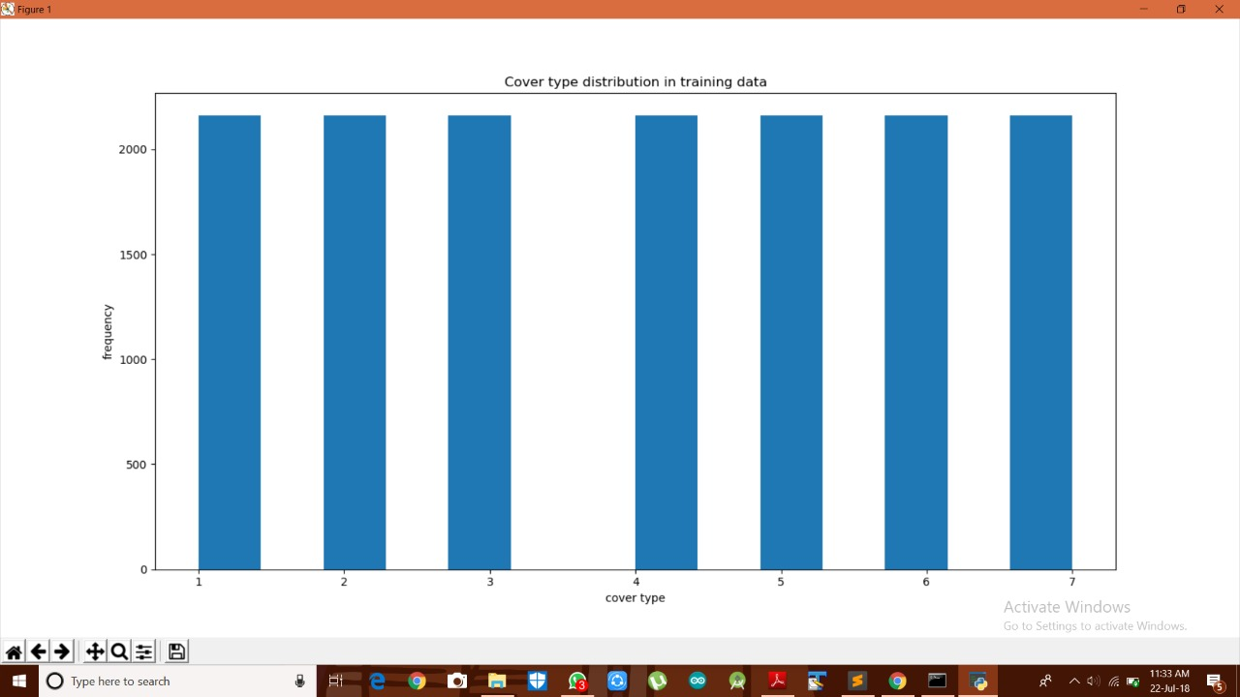
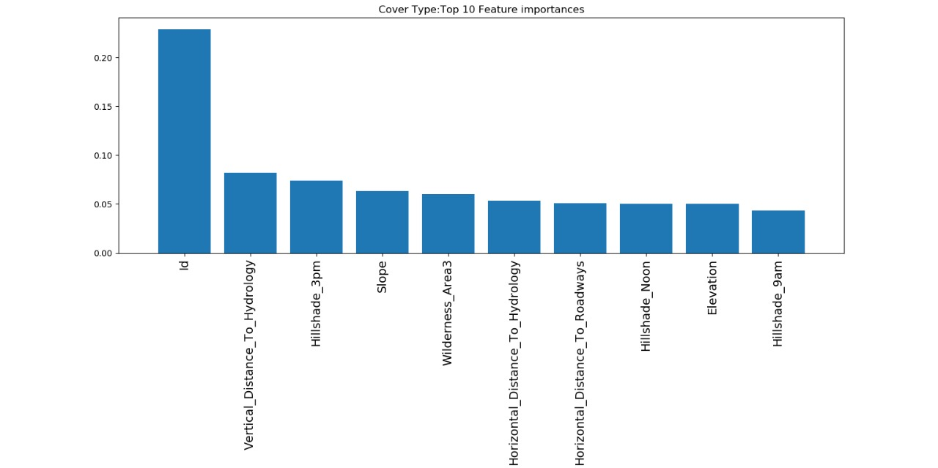
Data Visualization

Slide 7
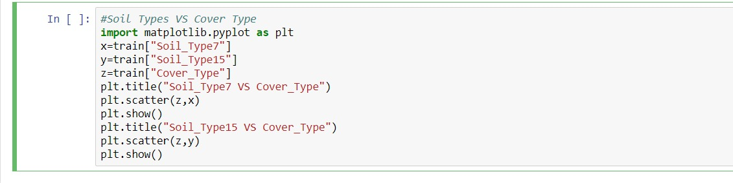
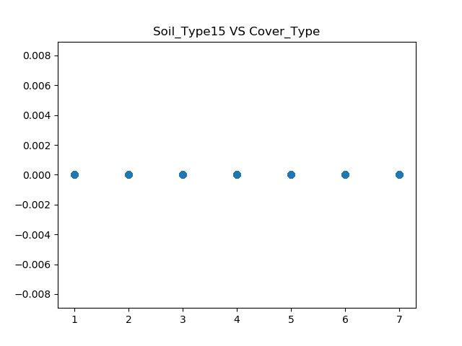
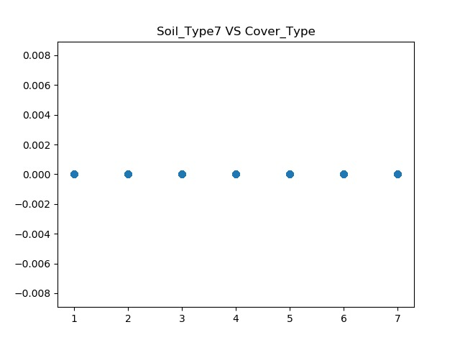

Slide 8
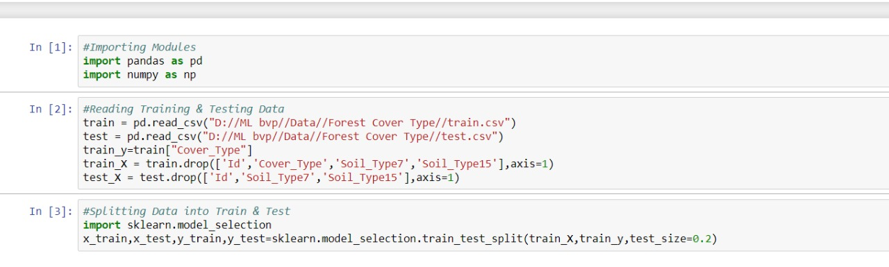
Importing files

Slide 9
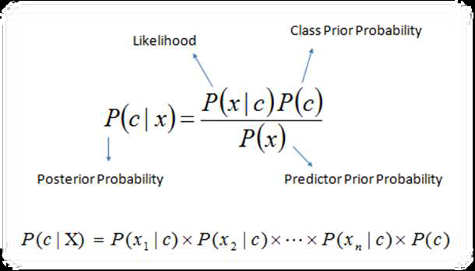
NAÏVE BAYES
The Naive Bayesian classifier is based on Bayes’ theorem with the independence assumptions between predictors.
A Naive Bayesian model is easy to build, with no complicated iterative parameter estimation which makes it particularly useful for very large datasets.

Slide 10
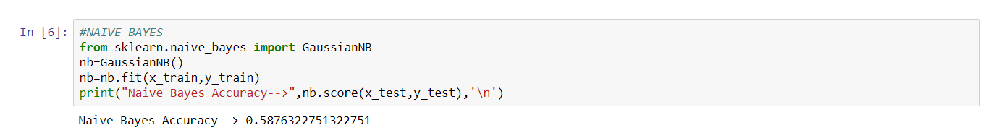
CODE:

Slide 11
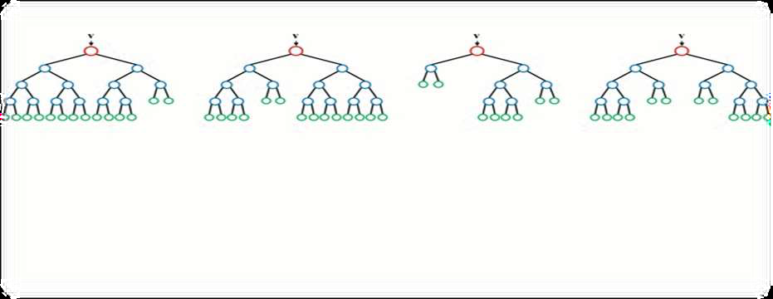
RANDOM FOREST
Random forest algorithm is a supervised classification algorithm. As the name suggest, this algorithm creates the forest with a number of trees.
In general, the more trees in the forest the more robust the forest looks like. In the same way in the random forest classifier, the higher the number of trees in the forest gives the high accuracy results.

Slide 12
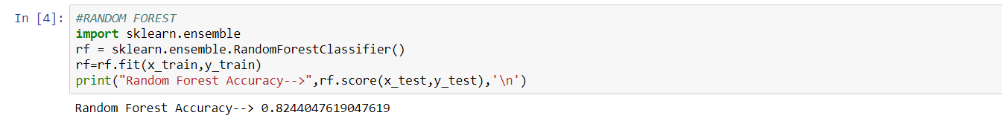
CODE:

Slide 13
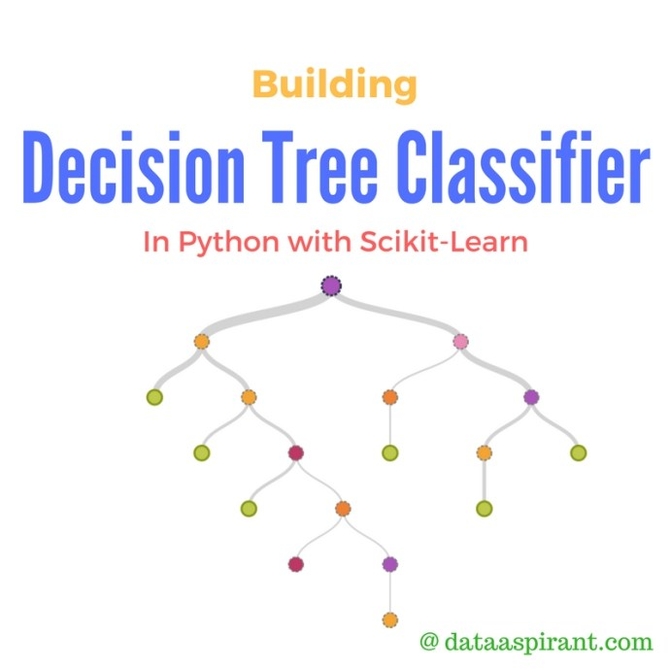
DECISION TREE CLASSIFIER
A decision tree is a decision support tool that uses a tree-like graph or model of decisions and their possible consequences, including chance event outcomes, resource costs, and utility. It is one way to display an algorithm that only contains conditional control statements.
Decision trees are commonly used in operations research, specifically in decision analysis, to help identify a strategy most likely to reach a goal, but are also a popular tool in machine learning.

Slide 14
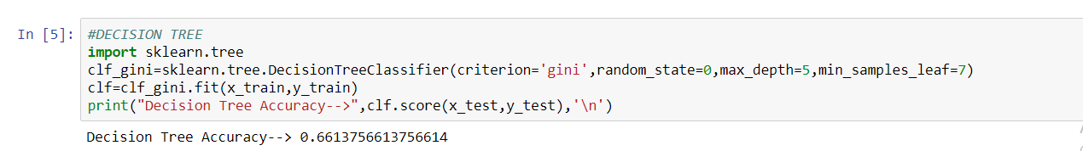
CODE:

Slide 15
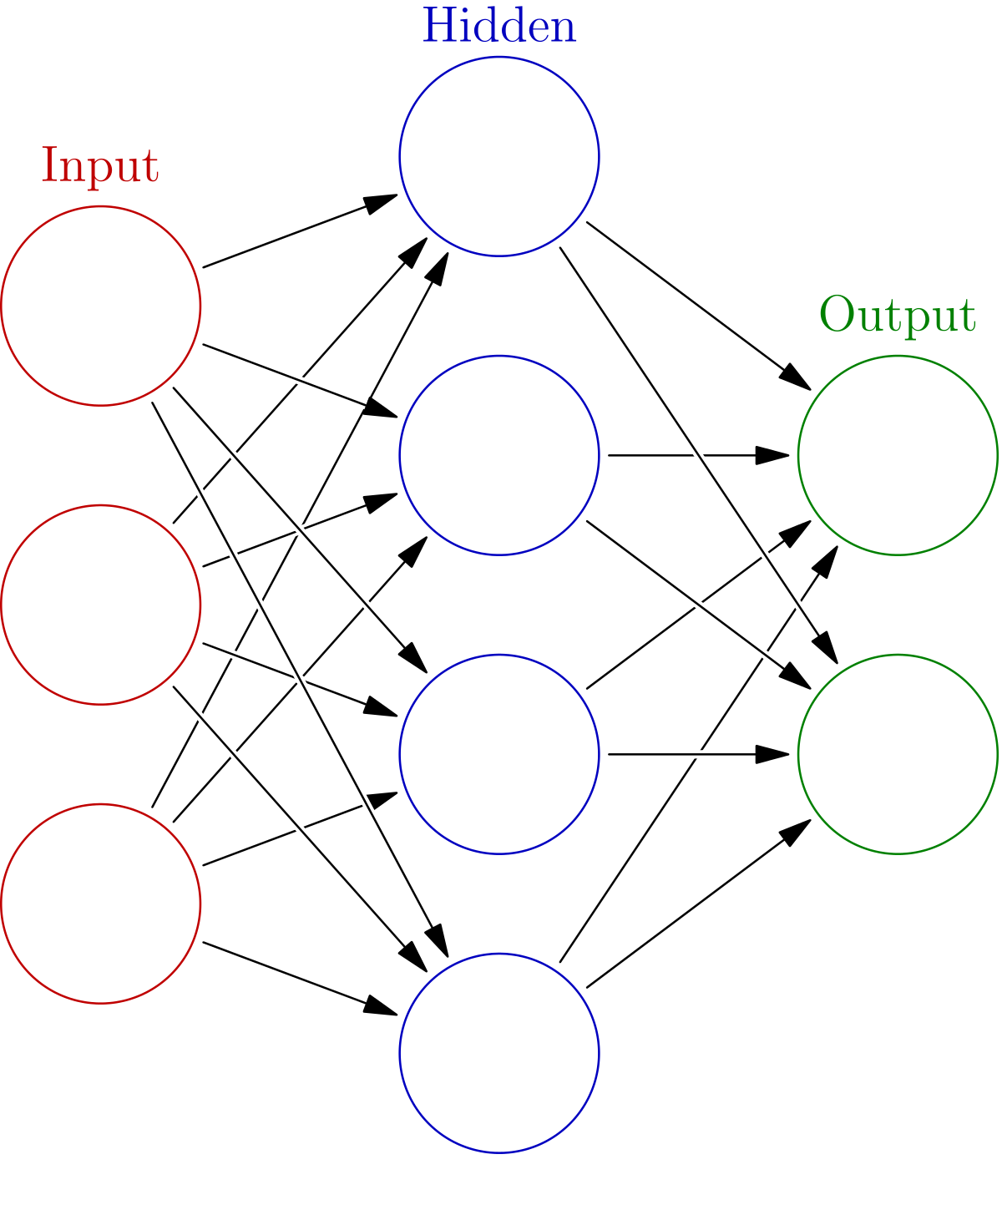
DNN CLASSIFIER:
A deep neural network (DNN) is an artificial neural network (ANN) with multiple layers between the input and output layers.
The DNN finds the correct mathematical manipulation to turn the input into the output, whether it be a linear relationship or a non-linear relationship.
The network moves through the layers calculating the probability of each output.

Slide 16
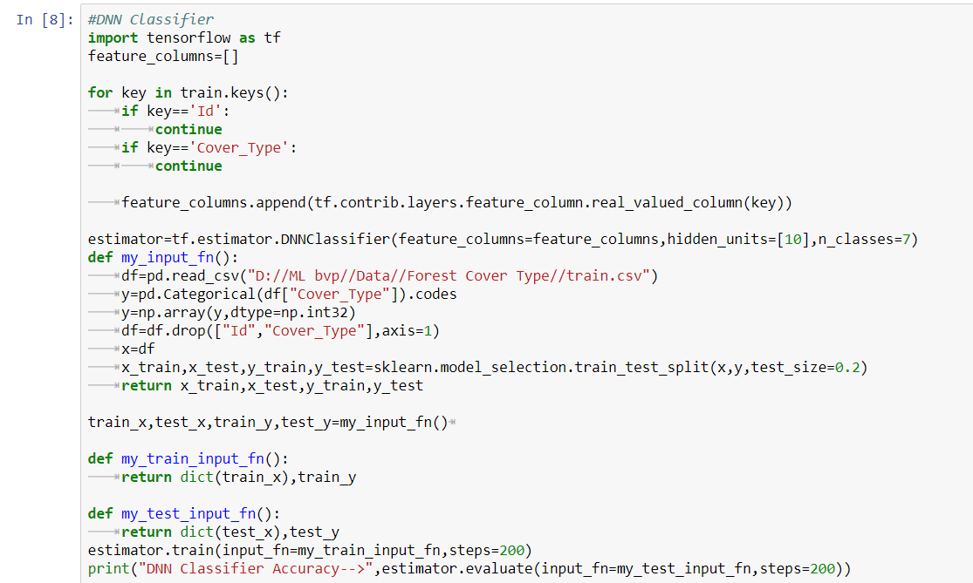
CODE:

Slide 17
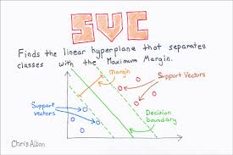
SUPPORT VECTOR CLASSIFIER(SVC)
support vector machines are supervised learning models with associated learning algorithms that analyze data used for classification and regression analysis.
In addition to performing linear classification, SVMs can efficiently perform a non-linear classification using what is called the kernel trick, implicitly mapping their inputs into high-dimensional feature spaces.

Slide 18
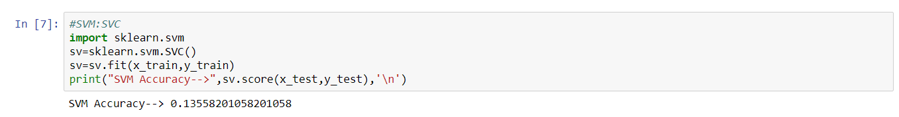
CODE:

Slide 19
conclusion
Efficiencies:
DECISION TREE ~ 67%
RANDOM FOREST ~ 82.4%
NAÏVE BAYES ~ 59%
SVC ~ 13%
DNN CLASSIFIER ~ 15%
RANDOM FOREST comes out to be the best fitted model for this problem

Slide 20
BIBLIOGRAPHY
www.analyticsvidhya.com
www.stackoverflow.com
www.kaggle.com
www.eckovation.com
www.wikipedia.com

Slide 21


